Slide 1
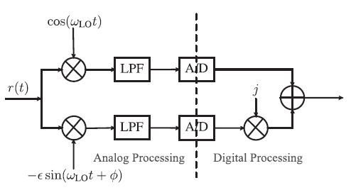
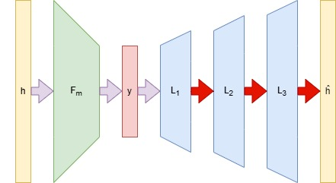
Title slide + image
Deep Learning CS under IQ imbalance for Chanel Estimation
EE4740 | Daan van Haasteren and Tom Lijding

Slide 2

Introduction
High Frequency Networks
Advantages
Challenges
Enormous spectrum resources
Decrease in antenna size requirements
Many more…
Imbalance in the in-phase and quadrature branches at RX
Non-linearity of power amplifier
Phase noise in LO
Channel Estimation in mmWave
Phased Arrays
Why
Challenges
Beam forming to maximize SNR and aligning beams
Large overhead in typical exhaustive beamscanning
Strict hardware constraints
Figure 1: Phased-array setup

Slide 3
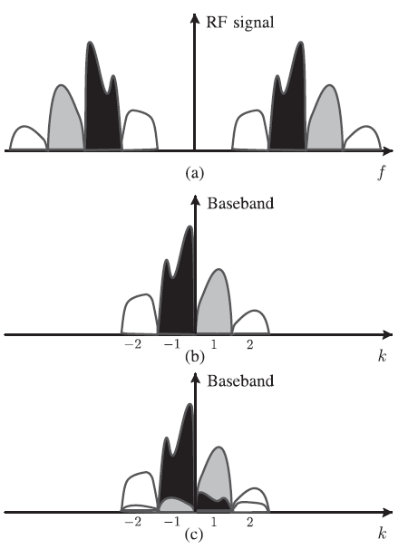
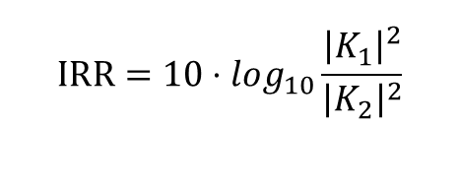
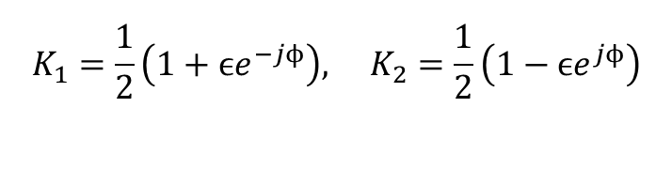
IQ Imbalance Recap
Illustrations
Mathematical Model
Signal
$$y_{IQI}[k]=K_{1}y_{baseband}[k]+K_{2}y_{baseband}^{∗}[k]$$
Imbalance coefficients
$$K_{1}=\frac{1}{2}\left(1+ϵe^{−jϕ}\right), K_{2}=\frac{1}{2}\left(1−ϵe^{jϕ}\right)$$
Figure 2: IQ imbalance model illustration, courtesy of [1]
Image rejection ratio
$$\text{IRR}=10⋅log_{10}\frac{{\left|K_{1}\right|}^{2}}{{\left|K_{2}\right|}^{2}}$$
Figure 3: Illustration of the effect of IQ imbalance on signal reconstruction, courtesy of [1]
[1]: A.-A. A. Boulogeorgos, V. M. Kapinas, R. Schober, and G. K. Karagian-nidis, “I/q-imbalance self-interference coordination,” IEEE Transactionson Wireless Communications, vol. 15, no. 6, pp. 4157–4170, 2016.

Slide 4
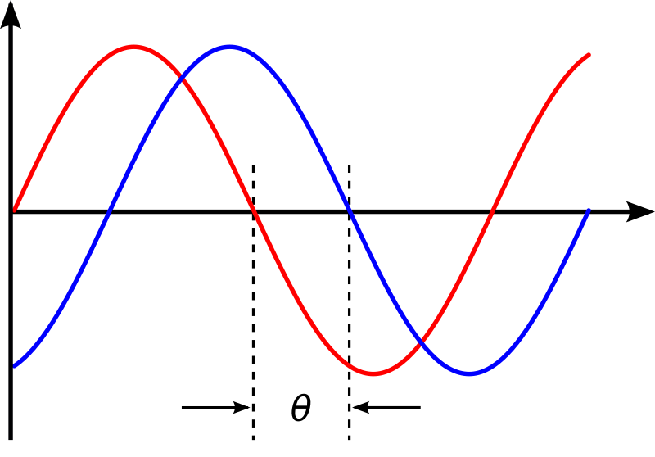


Motivation and Contribution
Challenge
Current approaches
Our approach
IQ imbalance
Digital signal processing (I/Q-Imbalance Self-Interference Coordination) [1]
Autoencoder based signal reconstruction
Measurement overhead
Exhaustive beamscanning, convolutional compressed sensing [2]
Autoencoder based CS
Hardware restrictions
Quantization [2]
Pytorch compatible CS matrix optimization
Advantages
[1]: A.-A. A. Boulogeorgos, V. M. Kapinas, R. Schober, and G. K. Karagian-nidis, “I/q-imbalance self-interference coordination,” IEEE Transactionson Wireless Communications, vol. 15, no. 6, pp. 4157–4170, 2016.
[2]: N. J. Myers, Y. Wang, N. Gonz´alez-Prelcic, and R. W. Heath, “Deeplearning-based beam alignment in mmwave vehicular networks,” inICASSP 2020-2020 IEEE International Conference on Acoustics, Speechand Signal Processing (ICASSP). IEEE, 2020, pp. 8569–8573.
Lightweight (3 Linear Layers) complete negation of IQ-imbalance (1% NMSE for selected configurations)
Reduction in measurements to just 50 for signals of length 100 and sparsity 10-30 (1% NMSE for selected configurations)

Slide 5



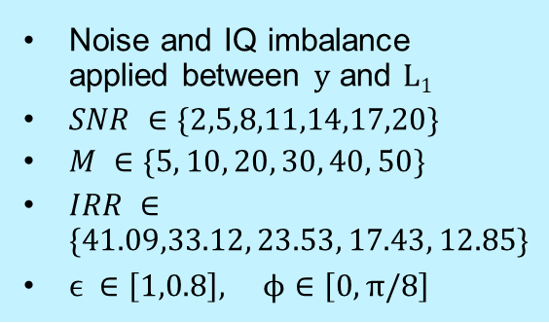




Methodology
Phased-array antenna model (CS matrix)
Autoencoder architecture
Dataset
Training size
Validation size
$$K=10000$$
$$K=10000$$
Generation
$$h_{i}=Fx_{i}$$
Figure 4: Phased-array antenna model
Figure 5: Autoencoder architecture visualized
Noise and IQ imbalance applied between y and L₁
$SNR ∈\{2,5,8,11,14,17,20\}$
$M ∈\{5, 10, 20, 30, 40, 50\}$
$IRR ∈\{41.09,33.12, 23.53, 17.43, 12.85\}$
$ϵ ∈\left[1,0.8\right], ϕ∈\left[0, π/8\right]$
$F∈C^{100×100}$:
DFT matrix
$$x_{i}∈R^{100}:$$
Sparse signal
$$f_{i}[n]=e^{jq_{i,n}},q_{i,n}∈\left[−π,π\right]$$
$$h_{i}∈C^{100}:$$
Dense signal

Slide 6
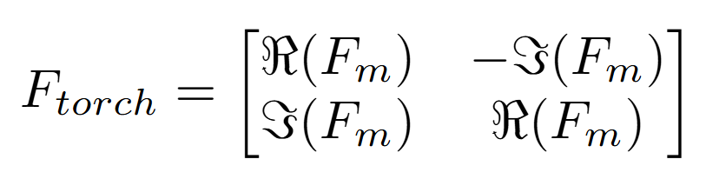
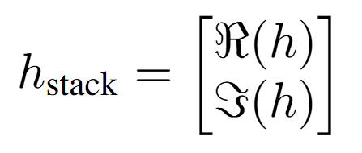



Methodology (contd.)
Restricted phased array antenna optimization
Complex numbers in Pytorch
Measurement matrix
Stacked vector
$$f_{i}\left[n\right]=e^{jq_{i,n}},q_{i,n}∈\{ ±π, ±\frac{1}{2}π, 0\}$$
Optimization problem
$$min\frac{1}{N}{\left|\left|h−f\left(h,w,b,q\right)\right|\right|}_{2}^{2}+λg\left(q\right)$$
Note: Decoding layers were not restricted to complex operations as this lead to performance gains
$$g\left(q\right)=\left|q\left(q−\frac{π}{2}\right)\left(q−π\right)\left(q+\frac{π}{2}\right)\left(q+π\right)\right|$$

Slide 7
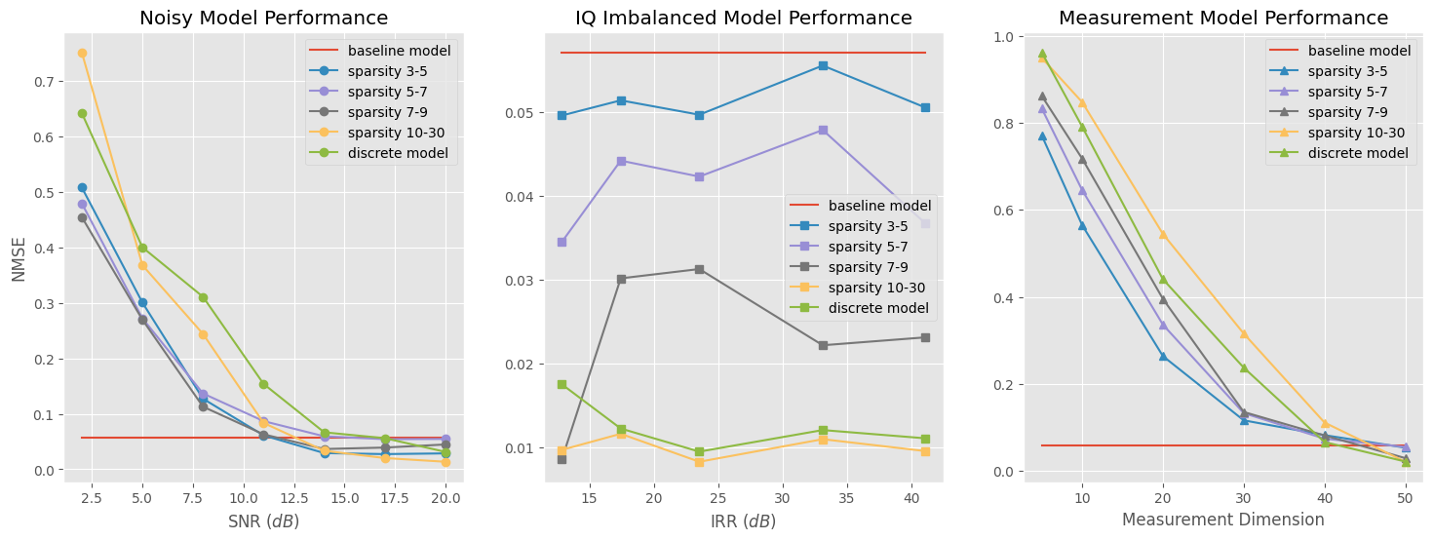
Results
Notes:
Negative trend for measurement size and SNR, larger encoding dim or larger SNR results in lower NMSE
No clear trend in IQ imbalance.
Discrete encoding matrix comparable performance, slightly worse with additive noise, in fact better with IQ imbalance, slightly worse with very small encoding dimensions.

Slide 8
Discussion
Negative correlations
High SNR
High encoding dimension
Discrete model
Notes:
Negative correlation with SNR and encoding dimension is known and to be expected.
For low SNR and encoding dim, models corresponding to dense x’s perform worse, to be expected (SNR trained on same encoding dim.) rule of thumb to have at least 2*s encoding dimension.
For high SNR and encoding dim it is reversed due to normalization with variance.
Discrete model performs worse in poor cases but converges to comparable performance in favorable cases. Due to more flexibility in measurement matrix.

Slide 9
Discussion
No correlation
Variation from optimization
Decreasing NMSE with increasing density
Notes:
Variation due to optimization nature of training NN
No correlation between IRR and performance means we compensate for Imbalance!
Due to constant disturbance which NN can compensate.
More dense x performs better due to normalization
Performance of discrete model due to chance?
Back to meaning -> using NN we can compensate for IQ imbalance, especially attention should be given to other noise in the environment and the choice of encoding dimension and discretization.
More research into discrete models needed. As it can be viable in the right conditions.

